Slide 1

Programming One (csc7050)
Aidan McGowan

Slide 2
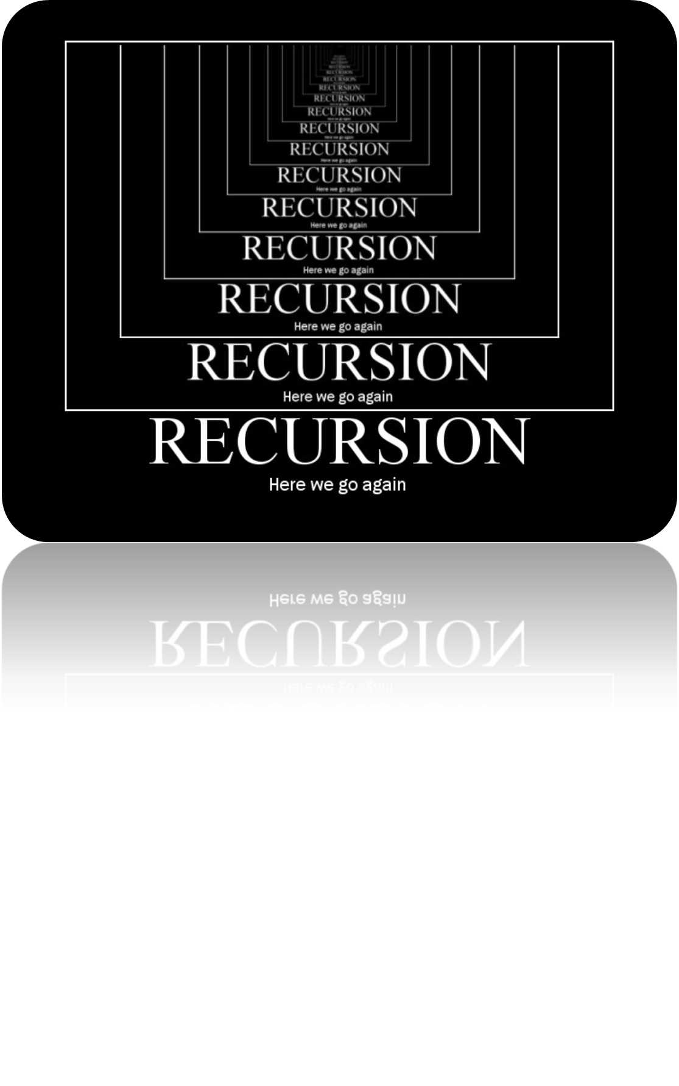

Slide 3
Recursion - introduction
The programs you developed so far are generally structured as methods that call one another in a hierarchical manner.
For some problems, it’s useful to have a method call itself.
A method that does so is known as a recursive method.

Slide 4
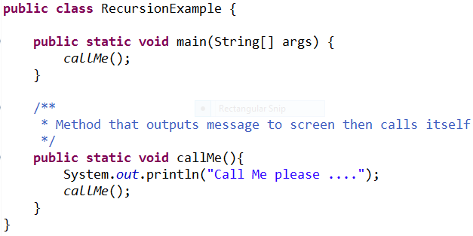

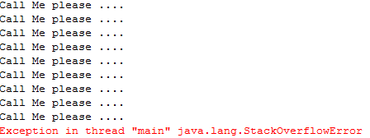
Caution : Recursion – a method calling itself

Slide 5
Recursive problem-solving -elements in common
When recursive method is called to solve a problem, it actually is capable of solving only the simplest case(s), or base case(s).
If the method is called with a base case, it returns a result.
If the method is called with a more complex problem, it typically divides the problem into two conceptual pieces—a piece that the method knows how to do and a piece that it does not know how to do.
To make recursion feasible, the latter piece must resemble the original problem, but be a slightly simpler or smaller version of it.

Slide 6
Recursive problem-solving -elements in common
Because this new problem looks like the original problem, the method calls afresh copy of itself to work on the smaller problem—this is referred to as a recursive call and is also called the recursion step.
The recursion step normally includes a return statement, because its result will be combined with the portion of the problem the method knew how to solve to form a result that will be passed back to the original caller.

Slide 7
Recursive problem-solving -elements in common
For the recursion to eventually terminate, each time the method calls itself with a simpler version of the original problem, the sequence of smaller and smaller problems must converge on a base case. When the method recognises the base case, it returns a result to the previous copy of the method. A sequence of returns ensues until the original method call returns the final result to the caller.

Slide 8
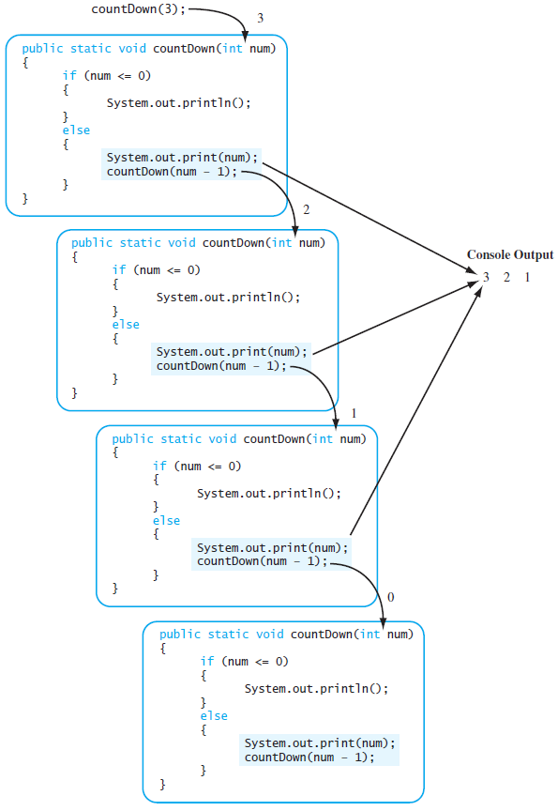
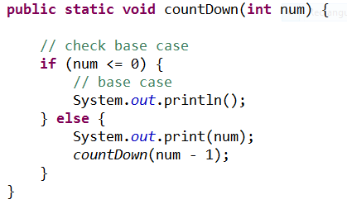
Countdown

Slide 9
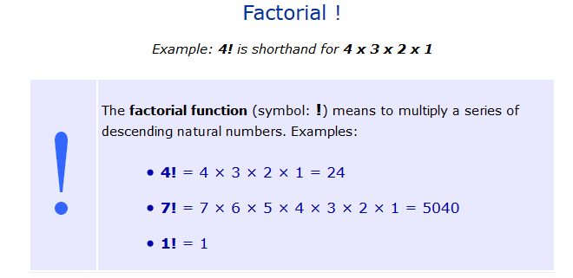
Factorial
The classic example of recursion is the computation of the factorial of a number. The factorial of a number N is the product of all the whole numbers between 1 and N.

Slide 10
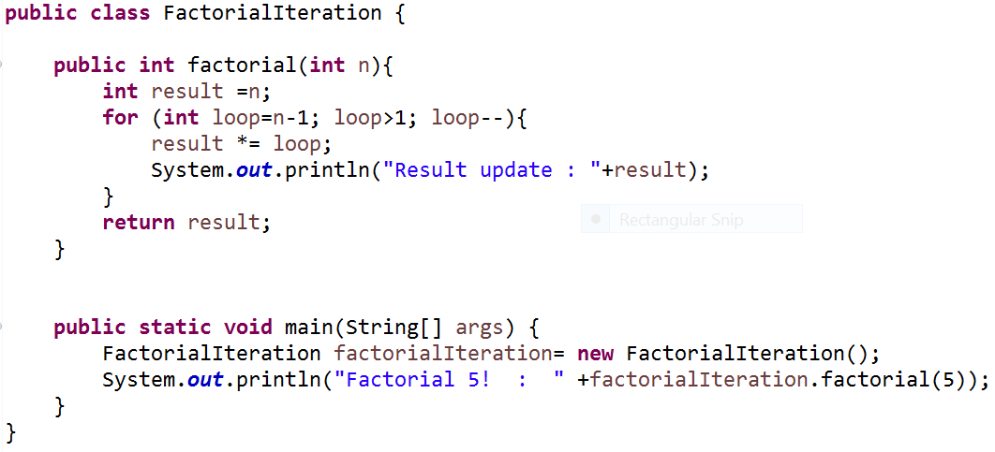
Factorial – with iteration
Method with a for loop to solve problem

Slide 11
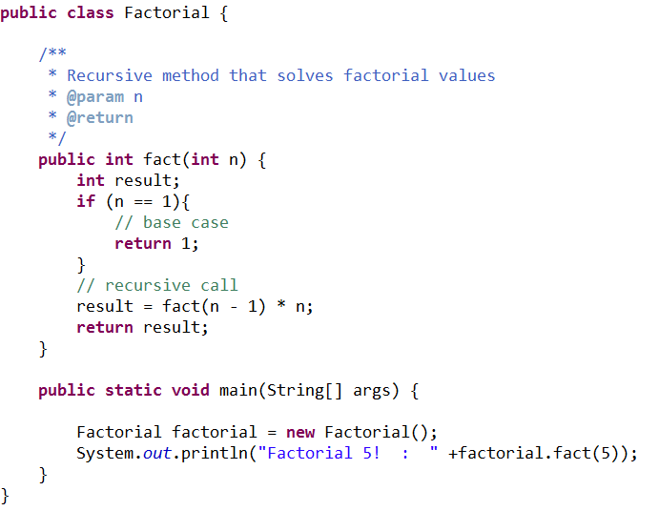
Factorial – with recursion
Base case
Recursive method call

Slide 12
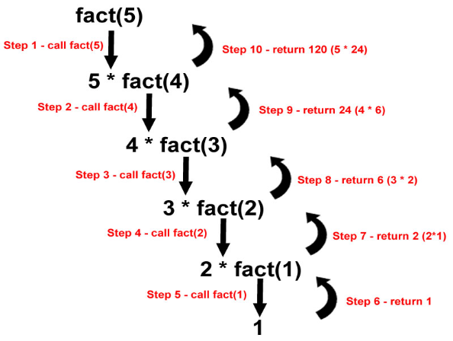
Recursion calls - stack

Slide 13
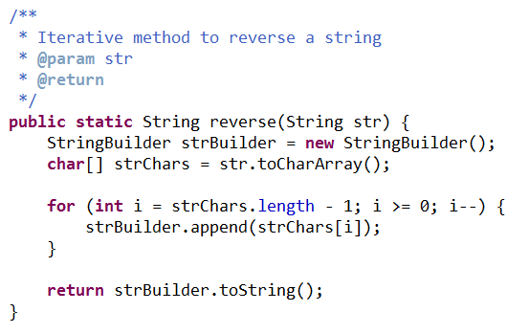
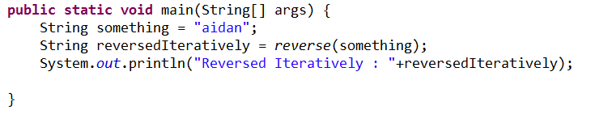
Reverse a string – Iterative approach

Slide 14
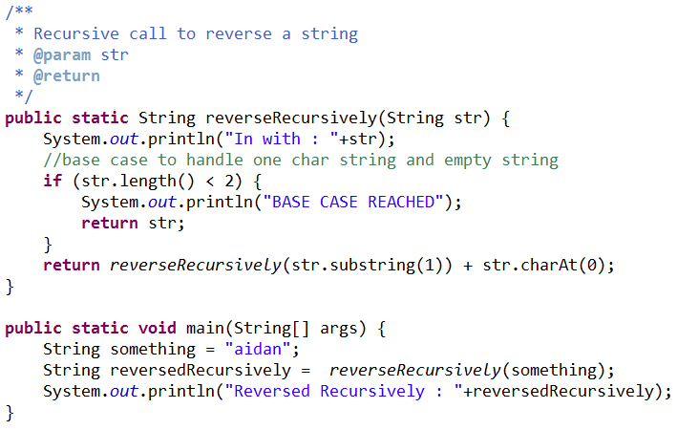
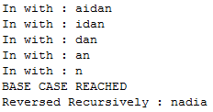
Reverse a string – Recursive approach

Slide 15
Under the hood ..
Methods pushed onto the stack
Methods popped off the stack
Step 5
Step 4
Step 3
Step 2
Step 1
reverseRecursively(“n”)
reverseRecursively(“an”)
reverseRecursively(“dan”)
reverseRecursively(“idan”)
reverseRecursively(“aidan”)
Return “n”
Return “n” + “a”
Return “na” + “d”
Return “nad” + “i”
Return “nadi” +“a”
Method Call Stack

Slide 16
Iteration vs. Recursion
Any problem that can be solved recursively can also be solved iteratively (non-recursively).
A recursive approach is normally preferred over an iterative approach when the recursive approach more naturally mirrors the problem and results in a program that is easier to understand and debug.
A recursive approach can often be implemented with fewer lines of code. Another reason to choose a recursive approach is that an iterative one might not be apparent.

Slide 17
Iteration vs. Recursion
Recursion has many negatives.
  It repeatedly invokes the mechanism and consequently the overhead, of method calls. This repetition can be expensive in terms of both processor time and memory space.
  Each recursive call causes another copy of the method (actually, only the method’s variables, stored in the activation record) to be created—this set of copies can consume considerable memory space. Since iteration occurs within a method, repeated method calls and extra memory assignment are avoided.

Slide 18
Iteration vs. Recursion
Avoid using recursion in situations requiring high performance.
Recursive calls take time and consume additional memory.
Recursion is commonly used for sorting and searching lists.

Slide 19
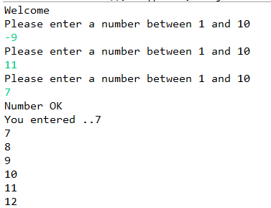
Recursion Exercise
Create a recursive method to repeatedly asks a user for a number between a range 1 – 10. Then output to screen starting at the user’s validated value up to 100. Use another recursive method to do this...
Notes:
package recursion.examples;
import java.util.Scanner;
public class ClassExercise {
private static Scanner scanner = new Scanner(System.in);
private static int number = 0;
public static void main(String[] args) {
System.out.println("Welcome");
checkRange();
System.out.println("You entered .." + number);
countUp(number);
}
public static void countUp(int num) {
// check base case
if (num == 101) {
// base case
System.out.println();
} else {
System.out.println(num);
countUp(num + 1);
}
}
public static void checkRange() {
System.out.println("Please enter a number between 1 and 10");
number = scanner.nextInt();
// check base case - i.e. number is between 1 - 10
if (number > 0 && number < 11) {
// base case
System.out.println("Number OK");
} else {
checkRange();
}
}
}

